Slide 1


Low-cost Laboratory Environment Monitoring and Alert System
Michael Braine
NCSLi, Portland, OR
29 August, 2018
www.nist.gov/pml/engineering-physics-division/dimensional-metrology
Dimensional Metrology Group
Engineering Physics Division
Physical Measurement Laboratory
Notes:
Good afternoon, I am Michael Braine and you are here to learn, hopefully, a bit about an inexpensive open-source laboratory environment monitoring system developed at NIST.

Slide 2
Overview
Purpose?
ISO 17025
Temperature and humidity in Dimensional Metrology
Design and cost
Example data
Lab environment incidents
Monitoring website
Link to Github download
www.nist.gov/pml/engineering-physics-division/dimensional-metrology
Dimensional Metrology Group
Engineering Physics Division
Physical Measurement Laboratory
Notes:
We have just a few things to go over before getting to the design and sharing of the software.

Slide 3
Overview
Purpose?
ISO 17025
Temperature and humidity in Dimensional Metrology
Design and cost
Example data
Lab environment incidents
Monitoring website
Link to Github download
www.nist.gov/pml/engineering-physics-division/dimensional-metrology
Dimensional Metrology Group
Engineering Physics Division
Physical Measurement Laboratory
Notes:
First, I wanted to discuss the reasoning for wanting to build something like this ourselves instead of using a commercial product.

Slide 4
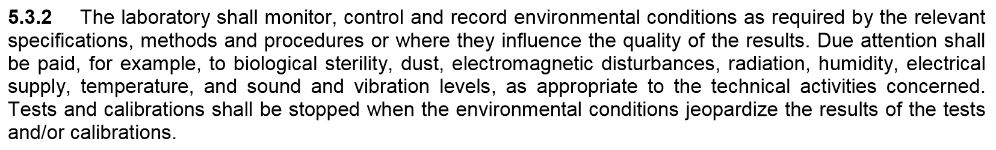
Purpose?
From ISO 17025:2005, sec 5.3.2:
www.nist.gov/pml/engineering-physics-division/dimensional-metrology
Dimensional Metrology Group
Engineering Physics Division
Physical Measurement Laboratory
Notes:
First, ISO 17025 says you must maintain a log of your environment that affects measurements. In our labs we have traditionally done this through a rotary chart recorder or with the various sensors that help our labs maintain our desired environment, but unless you knew how to access the data from the HVAC system, it is somewhat impractical for the average user and cumbersome during audits. Because these sensors are used to maintain our labs environment, they are wisely non-networked.
Secondly, and lets be honest, most staff will only access the data when required, no one will really go out of their way to check the system for whether the labs have been behaving recently until they attempt to make a measurement. In this case, the lab could have been out of specification for hours or even days if after a weekend. For dimensional metrology, a weekend outage can be detrimental to your workload because a lot of us use large heavy granite slabs that will absorb a lot of heat and take a very long time to return to equilibrium, well after the environment in the room has.

Slide 5
Purpose?
Dimensional Metrology Group
Identified need to be informed of weekend outages
Large volume CMMs with low uncertainties (M48s), instrumentation sensitive to environment changes
Commercial systems
Fairly expensive
Many, if not all, hosted data offsite (BIG no-no for NIST IT Security)
www.nist.gov/pml/engineering-physics-division/dimensional-metrology
Dimensional Metrology Group
Engineering Physics Division
Physical Measurement Laboratory
Notes:
In our group, for the M48 CMMs, John Stoup has uncertainties in the tens of nanometers over 1.2 meters on his longest measurement axis. After a short outage of half a degree Celsius for 5 or 10 minutes, this sets him back at least several hours, more if during a measurement program. Depending on how much heat a steel artifact absorbs in those 10 minutes, a 1.2 meter steel artifact could increase in length up to 7 micrometers. The error will be magnified depending on the bending of the structure. During a weekend event where the temperature spikes to 25 to 30 degrees C for the majority of the weekend, the M48 CMMs are down for 3 to 4 days. If the humidity increases, then the issue of risk of water damage to priceless instrumentation or customer artifacts is raised. There have been times when HVAC controls have randomly failed, 25 to 30 degrees C is not isolated to these maintenance outages.

Slide 6
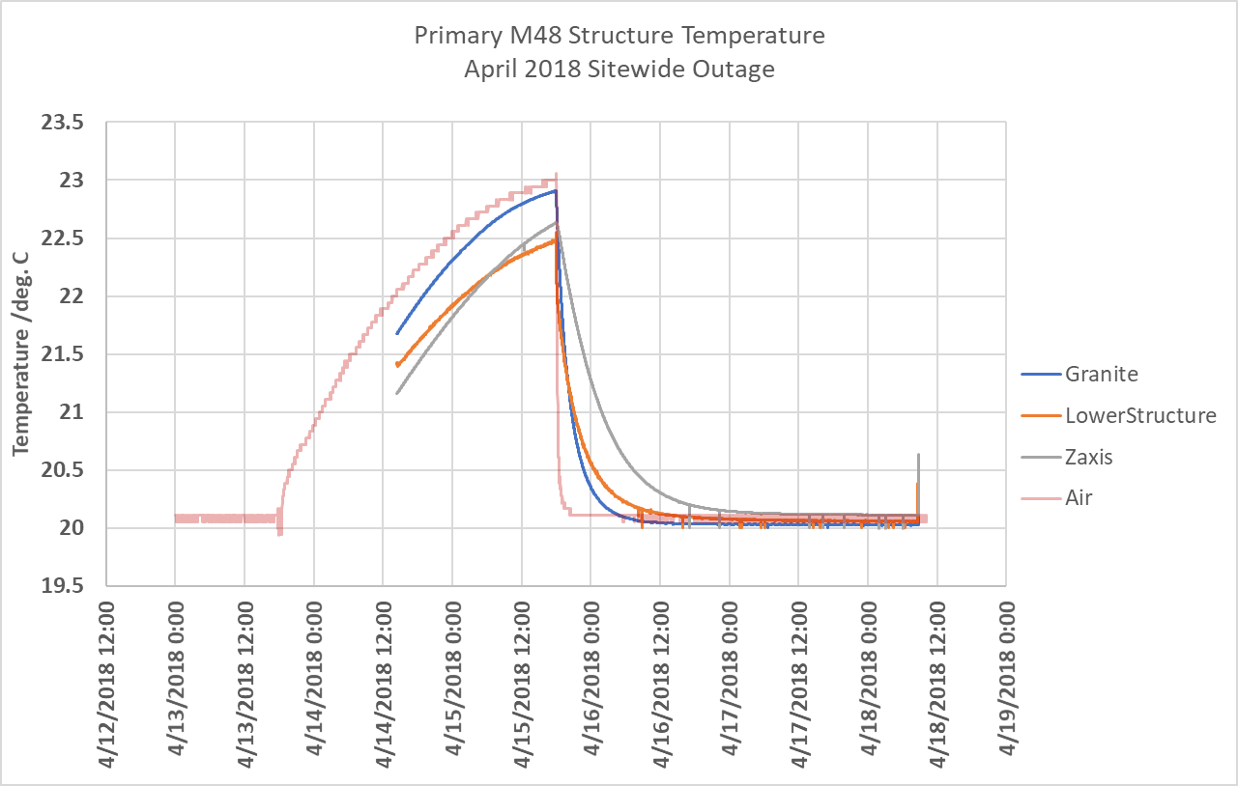
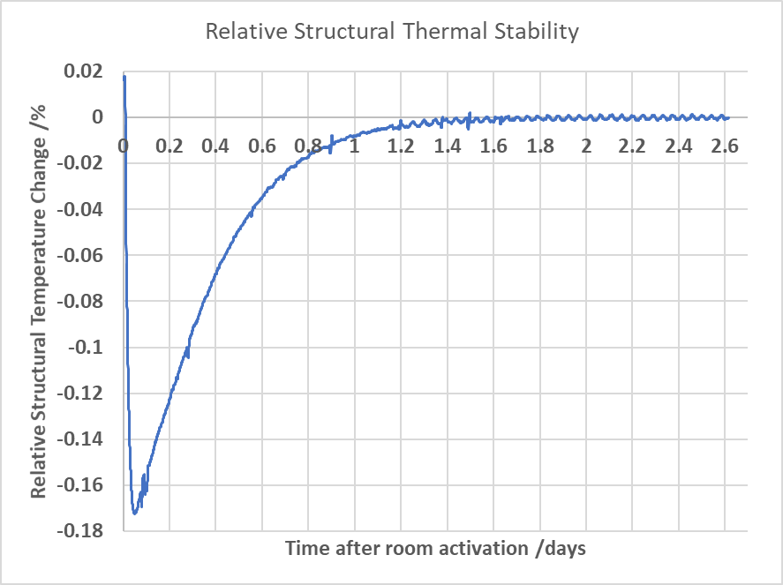
Purpose
www.nist.gov/pml/engineering-physics-division/dimensional-metrology
Dimensional Metrology Group
Engineering Physics Division
Physical Measurement Laboratory
Notes:
Something that I have been curious about is when we have planned maintenance outages for the HVAC systems twice per year, how hot does a CMM really get, and how long does it take to return to temperature? For the past sitewide outage in April, our environment system was operational and logging, but we placed a few sensors in key locations throughout the primary M48’s structure to estimate the structure temperature. It took approximately 2-2.2 days for the z-axis, the gray line, to stop measurably changing temperature. Since this is an approximation, it is in our interests to add a safety factor on to ensure temperatures in the core of the instrument have also stabilized, hence allowing 3-4 days for our CMMs to settle.

Slide 7
Purpose?
Dimensional Metrology Group
Identified need to be informed of weekend outages
Large volume CMMs with low uncertainties (M48s), instrumentation sensitive to environment changes
Commercial systems
Fairly expensive
Many, if not all, hosted data offsite (BIG no-no for NIST IT Security)
www.nist.gov/pml/engineering-physics-division/dimensional-metrology
Dimensional Metrology Group
Engineering Physics Division
Physical Measurement Laboratory
Notes:
So, what if we knew exactly when a lab goes out of specification and take a proactive approach to fixing the lab so that the environment can come back sooner and lose only hours instead of days? Hence, a system that monitors the environment and raises alerts under various conditions.
We found most if not all commercial products that have the desired monitoring and messaging capabilities require the data to be hosted offsite, which was a huge no-no for NIST IT security. Many of these systems are fairly expensive, and with nearly 30 labs, it would be an enormous expense for our group. So we looked into building a system that the user would have total control over, and found it to be relatively inexpensive in both time and capital. Python 3 programming language includes in its base easy-to-use libraries for sending text messages and emails and Python has a large scientific community, everyone here should know Python. If you take away anything here, learn to read and write Python programs.

Slide 8
Overview
Purpose?
ISO 17025
Temperature and humidity in Dimensional Metrology
Design and cost
Example data
Lab environment incidents
Monitoring website
Link to Github download
www.nist.gov/pml/engineering-physics-division/dimensional-metrology
Dimensional Metrology Group
Engineering Physics Division
Physical Measurement Laboratory
Notes:
Now we have a desire to be more informed of our environment. How does one build a system when provided the software?

Slide 9
Design and cost
Open Source Design
Raspberry Pi 3 Model B using Raspbian (Debian-based Linux)
5 inch 800x480 display (optional)
Commercial sensor, need serial communications or can read through RPi GPIO pins
Traceable calibration, of course
Python 3 language – many, many scientific packages to expand capability
Data stored by month-year locally on Raspberry Pi 3
Library to send email and text messages
www.nist.gov/pml/engineering-physics-division/dimensional-metrology
Dimensional Metrology Group
Engineering Physics Division
Physical Measurement Laboratory
Notes:
I personally believe heavily in open-source so that is the approach we took, and so that we could share the resulting system, get input, and expand it.
For the hardware: the backbone of the system is just a Raspberry Pi 3 Model B that runs a Debian-based Linux OS called Raspbian. We chose this platform because we needed something with a low heat signature and a small footprint to minimize the effect of its presence in the lab. Many of our labs are extraordinarily sensitive. The Raspberry Pi platform also provides limitless expansion if we ever want to integrate other lab devices to our system. We added a 5 inch display to put the most recent environment in clear view of anyone in the room, but the system can be run without a display to minimize heat input. Finally, we needed a means to gather temperature and humidity. We purchased a commercially available sensor with a thermistor and hygrometer that had RS-232 capabilities and came with a traceable calibration, of course. The entire software makes use of popular Python libraries available in nearly every repository. Using serial communications, we capture the environment and store it locally on the raspberry pi. At the beginning of each month, a new file is automatically created where data for that month is stored.
Taking this system one step further, we also built an internal website that collects recent data from each device every 5 minutes, processes the data, and publishes interactive graphs with statistics for each building and lab. We’ll talk a little bit about this setup that I call the master system.

Slide 10
Design and cost
Raspberry Pi 3 $35
Display (optional) $60
Cables $30
3D printable case (mat’l only) $5
Commercial sensor $300
Sensor cost is variable, this was the cost of ours
Total without sensor = $130/lab
Total with sensor = $430/lab
www.nist.gov/pml/engineering-physics-division/dimensional-metrology
Dimensional Metrology Group
Engineering Physics Division
Physical Measurement Laboratory
Notes:
The total cost for a device is very little for each lab. Without the sensor, the system costs $130 per lab. With the sensor we purchased, $430 per lab. I don’t list the sensor we bought, because NIST cannot appear to endorse any particular company and therein arises a small problem we will talk about shortly. The raspberry pi platforms are open source, and different manufacturers print the same boards, so we can list it.

Slide 11
Design and cost
Schematic
AC Power In
Temperature/Humidity
Combo sensor
USB to RS-232
Raspberry Pi 3
Model B
HDMI
Display
USB Power
Space for expansion:
USB
GPIO
Bluetooth
Ethernet Out
www.nist.gov/pml/engineering-physics-division/dimensional-metrology
Dimensional Metrology Group
Engineering Physics Division
Physical Measurement Laboratory
Notes:
The overall design of the system is very simple. There are three components: a Rpi for the brain, an optional display, and a commercial combination temperature/humidity sensor so we did not have to build a circuit. There is plenty of room for functionality expansion and modularity with USB, and GPIO on the RPi

Slide 12
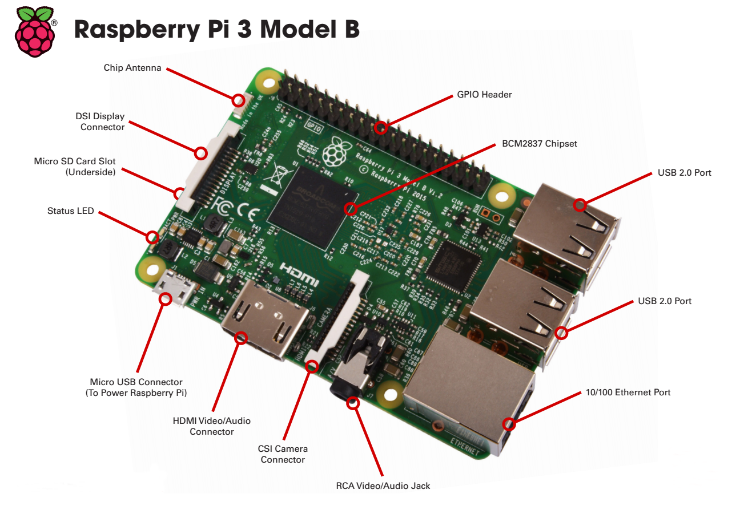
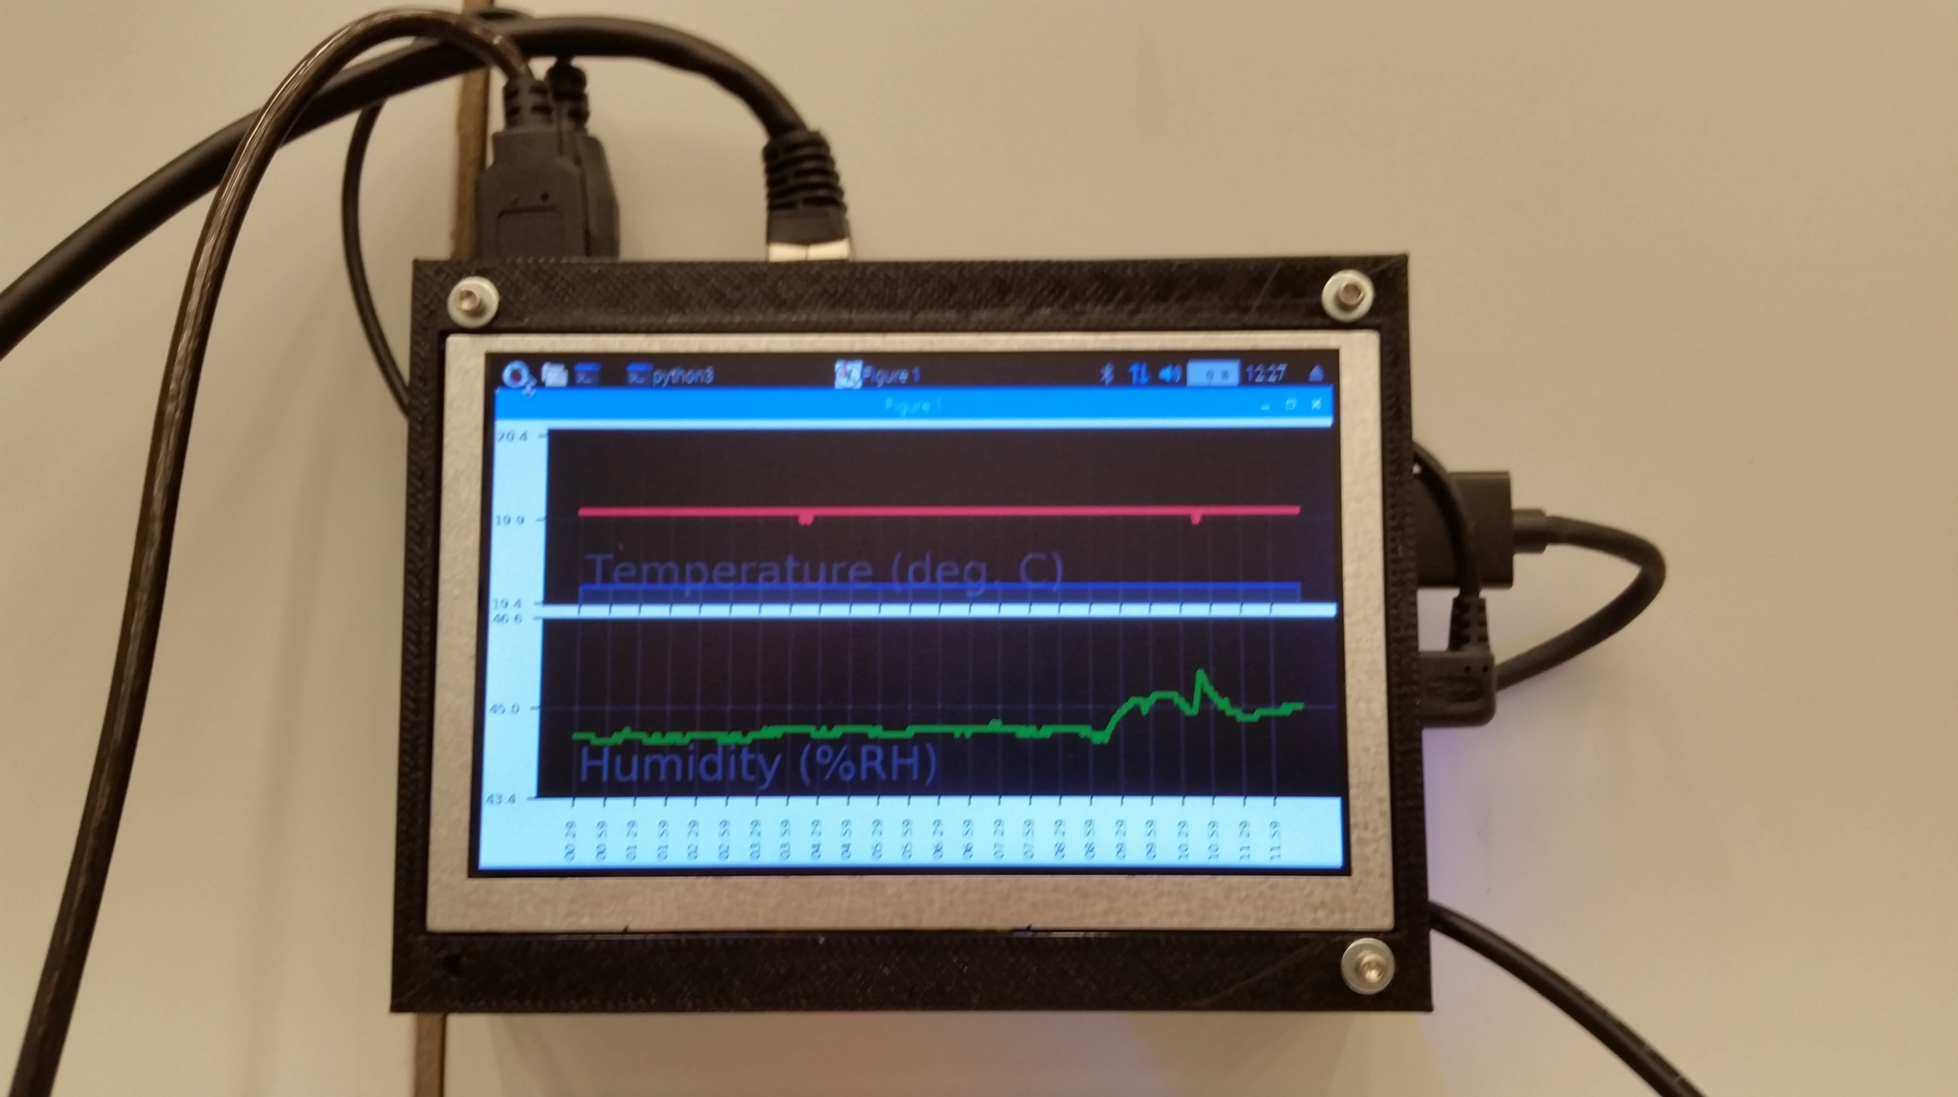
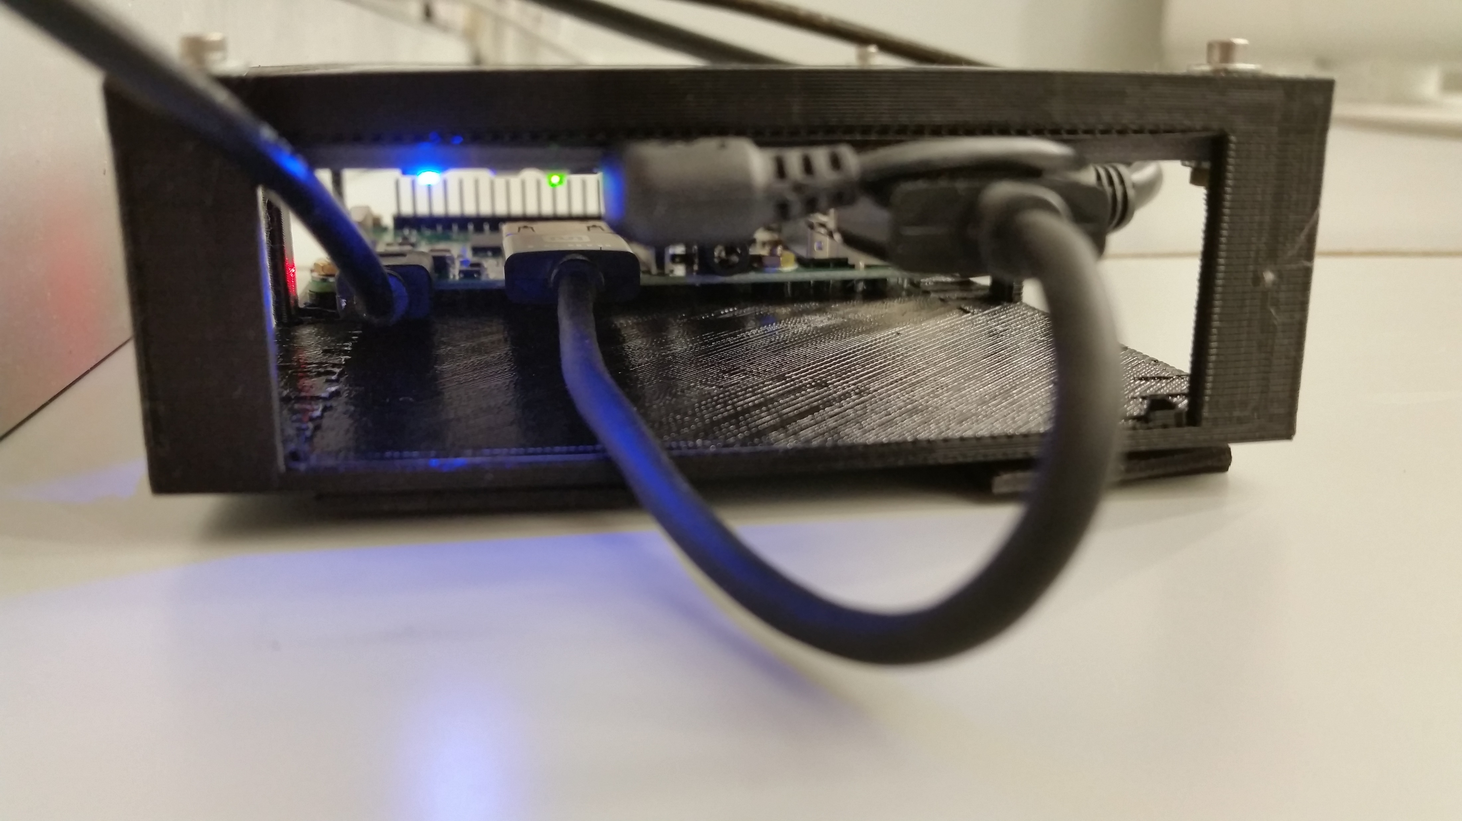
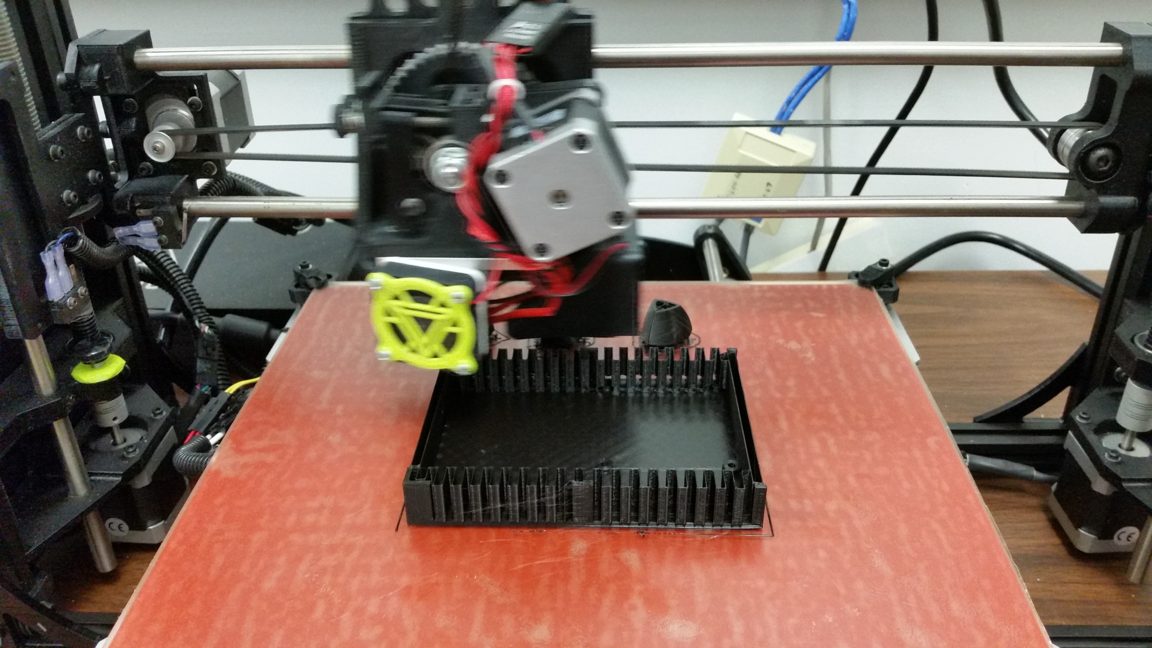
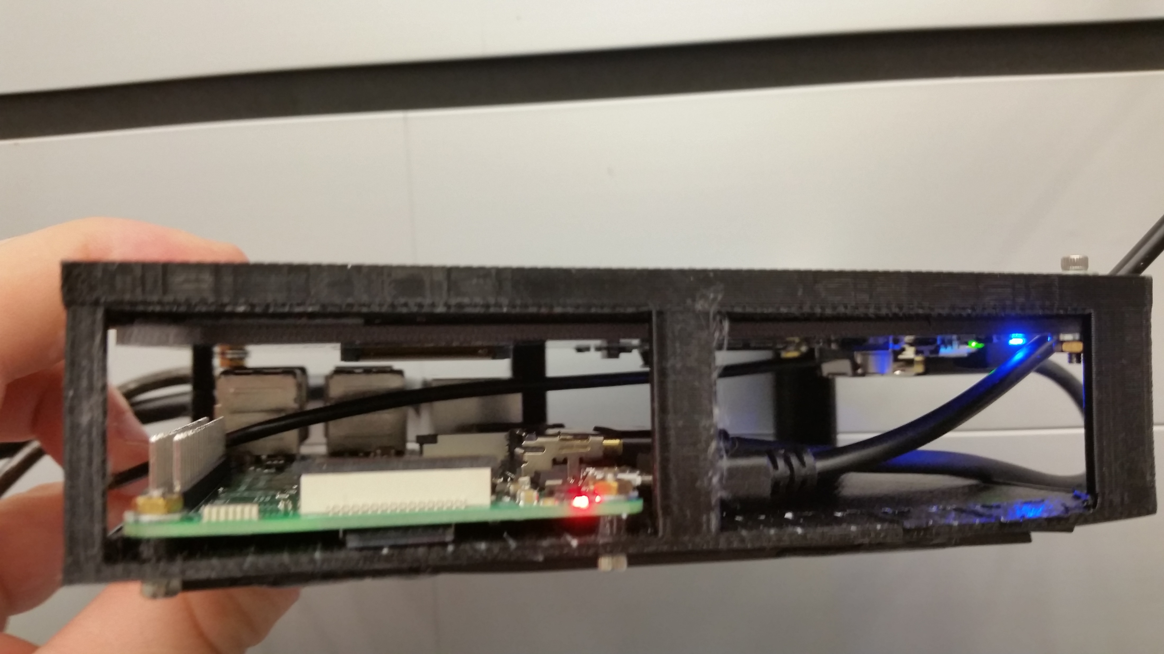
Design and cost
www.nist.gov/pml/engineering-physics-division/dimensional-metrology
Dimensional Metrology Group
Engineering Physics Division
Physical Measurement Laboratory
Notes:
On the left is one of the systems in our labs, displaying a graph of the environment from the past 12 hours. The top of the graph is temperature and bottom is humidity with some activity in the past few hours. I also have one with me, and you can see this setup is very small. The Rpi itself is the size of a credit card.
The case is 3D printed ABS plastic.

Slide 13
Design and cost
.csv data format (comma-separated values) Time, Temperature, Humidity 1, 20.1, 45.0 2, 20.2, 45.0 3, 20.0, 44.9 …, …, …
Easily openable in spreadsheets
Unique user message list for each lab
Unique environment outage settings for each lab
www.nist.gov/pml/engineering-physics-division/dimensional-metrology
Dimensional Metrology Group
Engineering Physics Division
Physical Measurement Laboratory
Notes:
The data is stored in .csv format, or comma-separated values, so that the data can be post-processed by another script, or easily opened in a spreadsheet like Excel.
We came up with a means to have a comprehensive list of users for all devices, with the ability to select which users receive messages from a particular lab. Similarly with the environment outage conditions, there is a comprehensive list of settings but each device only uses its own settings. These configurations are made by only editing their respective text settings files.
If you will be running many devices in a large network, as we do, I would recommend having a master system that can trickle user setting changes down to each device and aggregate data in one place. There are very easy to use, single line linux commands to do this. There is a link to an example of a master at the end of this, the master system that we designed.

Slide 14
Design and cost
A message is sent from any single device under one of three conditions:
When the set environment has exceeded limits, with a graph
When the set environment has returned within limits for a period of time, with a graph
When the set environment has exceeded limits, and the environment (T or RH) changes in increments of TincSet or RHincSet (LabSettings.py) until the environment returns within limits for a period of time, with a graph
www.nist.gov/pml/engineering-physics-division/dimensional-metrology
Dimensional Metrology Group
Engineering Physics Division
Physical Measurement Laboratory
Notes:
This describes the logic of when a message is sent.
In the first case, the device will send a message with an attached graph to its laboratory owners should temperature or humidity limits be exceeded.
In the second case, the device will send a message with an attached graph to its laboratory owners should temperature or humidity conditions return within limits after a period of time.
In the third case, when the environment is outside of the setpoints, the device will send a message for each occasion the environment changes by TincSet or RhincSet. E.g., the temperature upper limit is 25 deg. C, and TincSet is 5 deg. C, there will be a message generated at 30 deg. C, 35, deg. C, etc, until the temperature returns below 25 deg. C.

Slide 15
Overview
Purpose?
ISO 17025
Temperature and humidity in Dimensional Metrology
Design and cost
Example data
Lab environment incidents
Monitoring website
Link to Github download
www.nist.gov/pml/engineering-physics-division/dimensional-metrology
Dimensional Metrology Group
Engineering Physics Division
Physical Measurement Laboratory
Notes:
Next I have some data from the system to share with you. It has been fully active since only March this year, but we have already collected 400 megabytes of environment data from almost 30 labs, totaling somewhere around 10 million points in 6 months.

Slide 16
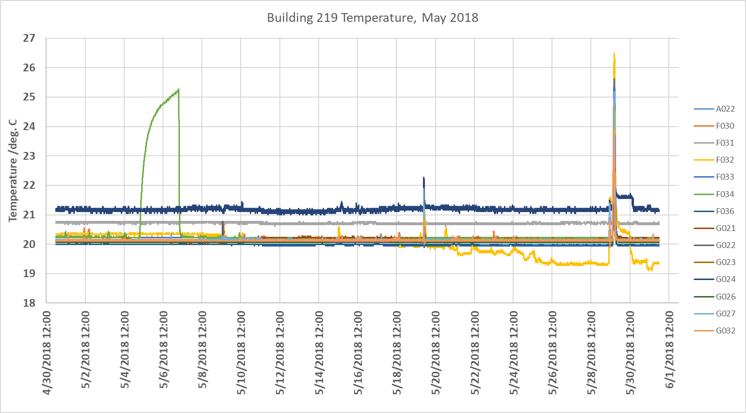
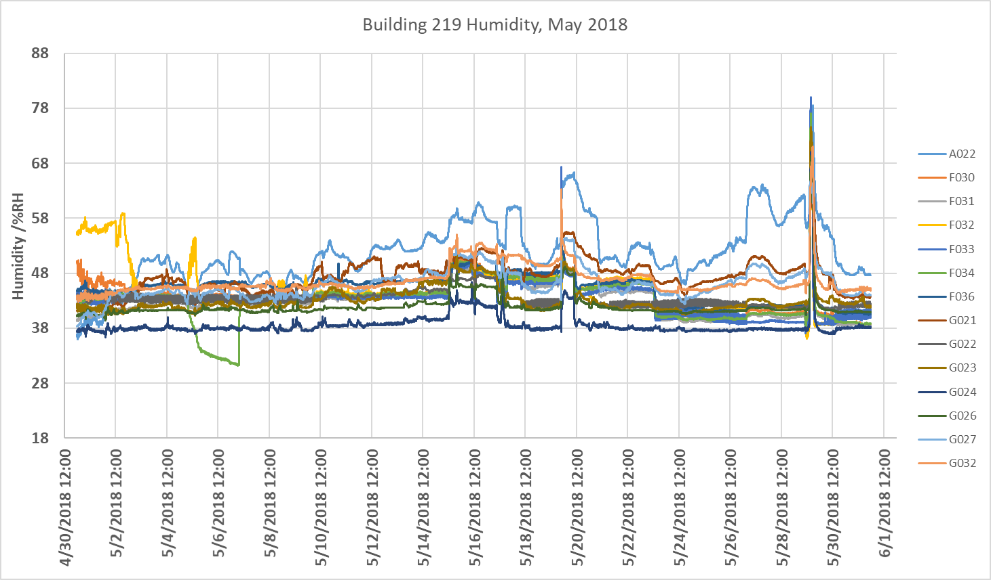
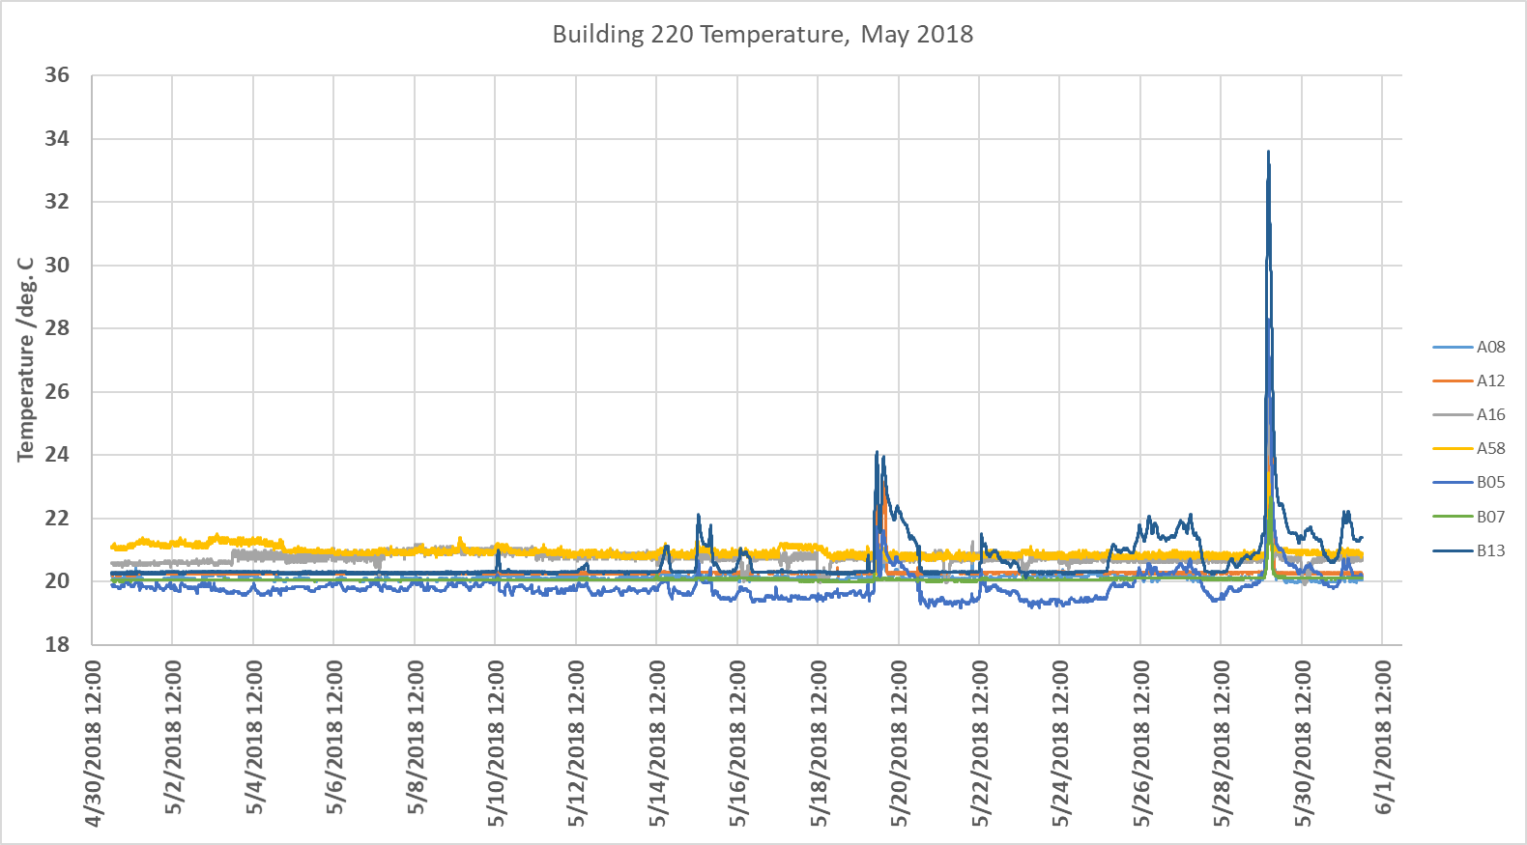
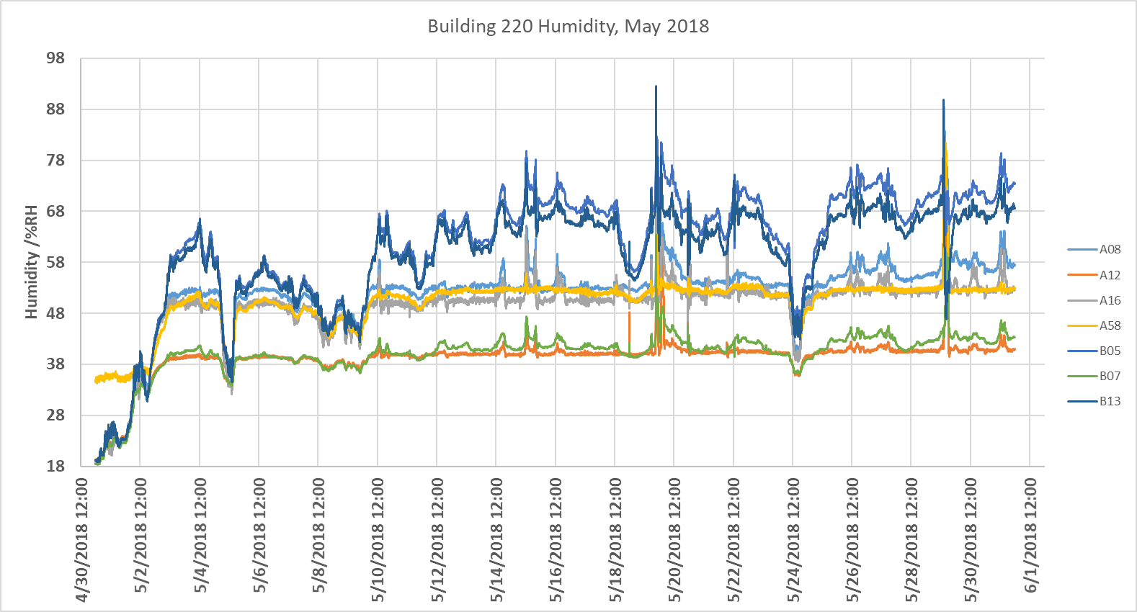
Example Data
Notes:
These graphs are from May of this year in two of our buildings. The top row is the AML, bottom row is our 50-year old Metrology building. Left column is temperature, right column is humidity. Each line is the environment of a particular lab. Unfortunately for our workload, fortunately for gathering data, this year has been a very active year. In Gaithersburg, MD there were several severe storms and a very intense windstorm in February that knocked out the power to NIST each time. For example, in May 2018 a power loss to a portion of site, twice, resulted in failure of HVAC environment. The red arrows indicate the environment outage in both buildings simultaneously. Our group is certain we knew about the outages before even the HVAC guys because this system will also turn itself back on in the case of a power outage, once it receives power again, and resumes sending messages. It sent message to everyone on each lab mailing list a total of 93 messages per outage, or an average of 3 per lab in the Dimensional Metrology Group. These events are an act of fate and cannot be timely resolved, but what can be resolved quickly are control board failures, HVAC motor belt failures, anything that can occur when you are not actively watching the environment. This system watches it and tells you when something undesirable has happened.
For example, earlier in May 2018 the control board of our gage lab, this green line, failed on a Saturday, May 5th. We knew something had gone wrong, diagnosed the issue, and had the control board replaced by the following Monday. We have also learned that our humidity controls in the AML building is not as good as we had thought. You can see by the high activity in the top right data.

Slide 17
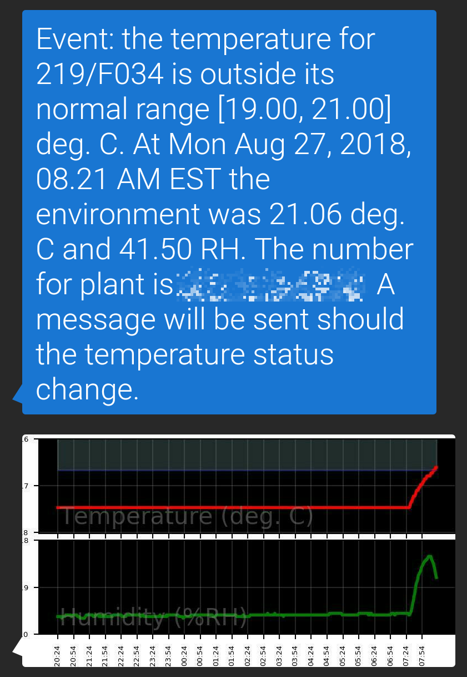
Example Data
www.nist.gov/pml/engineering-physics-division/dimensional-metrology
Dimensional Metrology Group
Engineering Physics Division
Physical Measurement Laboratory
Notes:
Here is an example of what the messages look like when coming by text message. It gives a description of the current environment at the time of event and notifies you in a separate message when conditions return. If you’re observant, this message was sent on Monday morning for our long block lab. If you have long blocks being calibrated by us, well, they may be delayed because of the high temperature. I do think it has since returned Monday afternoon or evening.

Slide 18
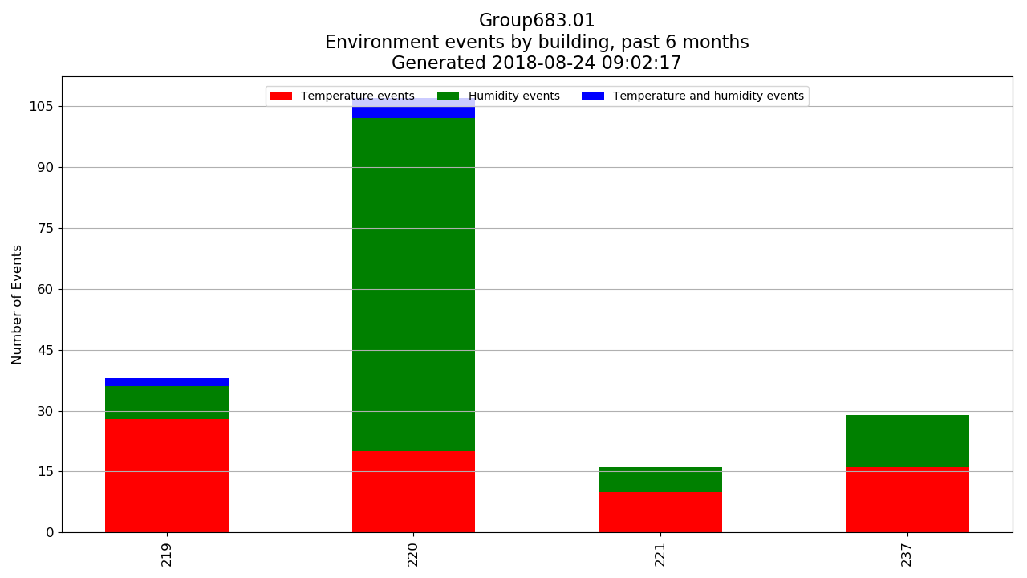
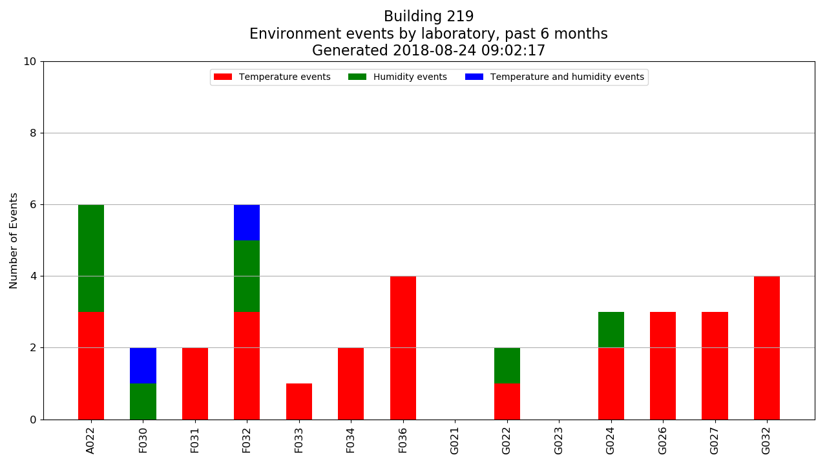
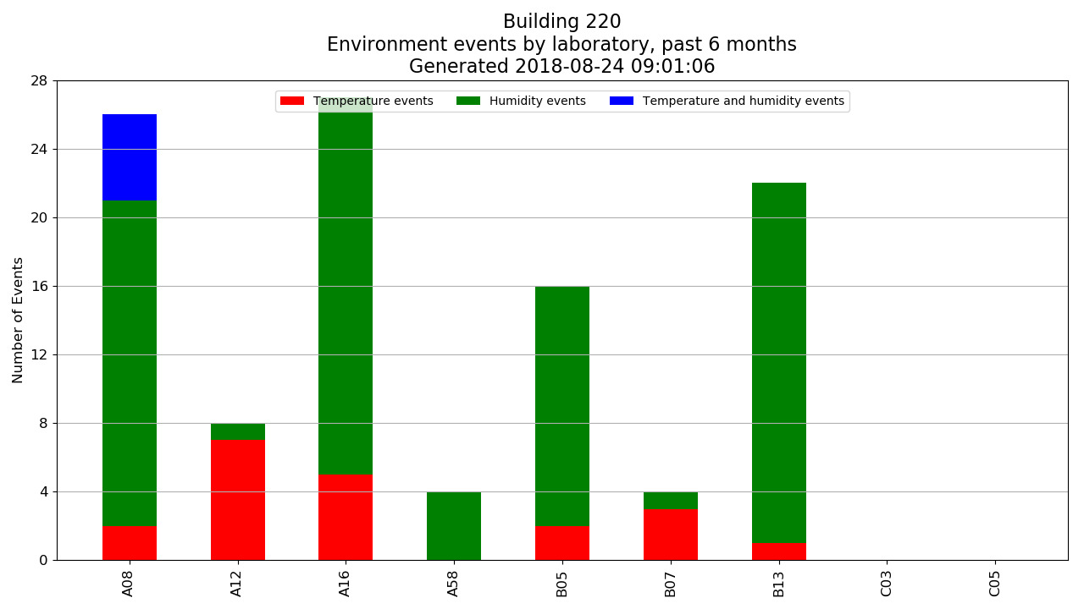
Example Data
www.nist.gov/pml/engineering-physics-division/dimensional-metrology
Dimensional Metrology Group
Engineering Physics Division
Physical Measurement Laboratory
Notes:
Something else we can do with the data is examine how often our environments exit desirable conditions within our group. The top chart is number of outages within our group per building for the past 6 months. The different colors on the stacked bar charts represent the type of event, humidity, temperature, or both. We can then break down the data further to examine, within each building, what has happened in each lab, and determine how reliable each lab is according to our defined environment conditions, even determine a percentage uptime if desired.

Slide 19
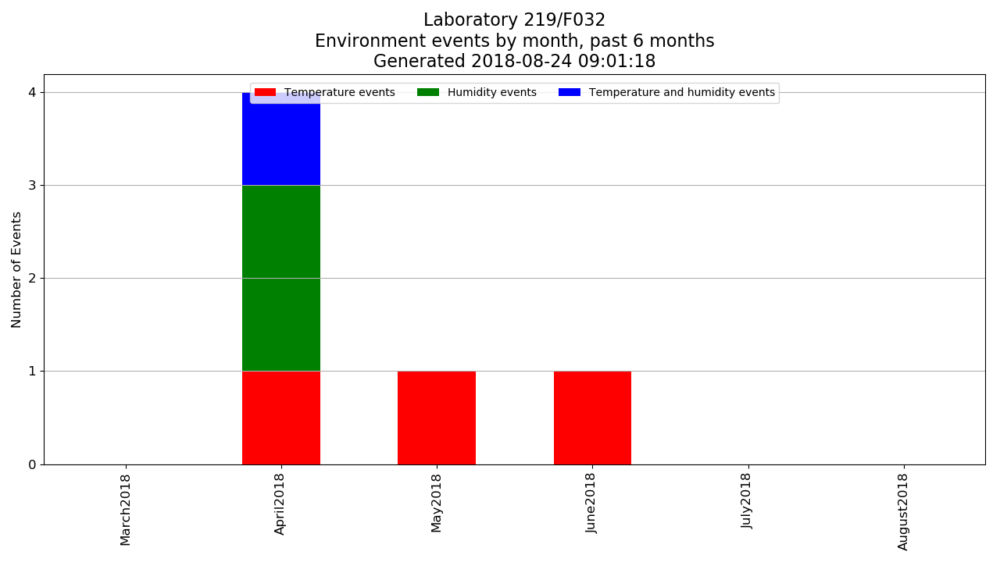
Example Data
www.nist.gov/pml/engineering-physics-division/dimensional-metrology
Dimensional Metrology Group
Engineering Physics Division
Physical Measurement Laboratory
Notes:
And from that data, we can examine when an individual lab has had the most activity. I randomly picked one lab to show you, in this case the optical fiber comb lab. In April there was a fair amount of activity here, but seems to be improving.

Slide 20
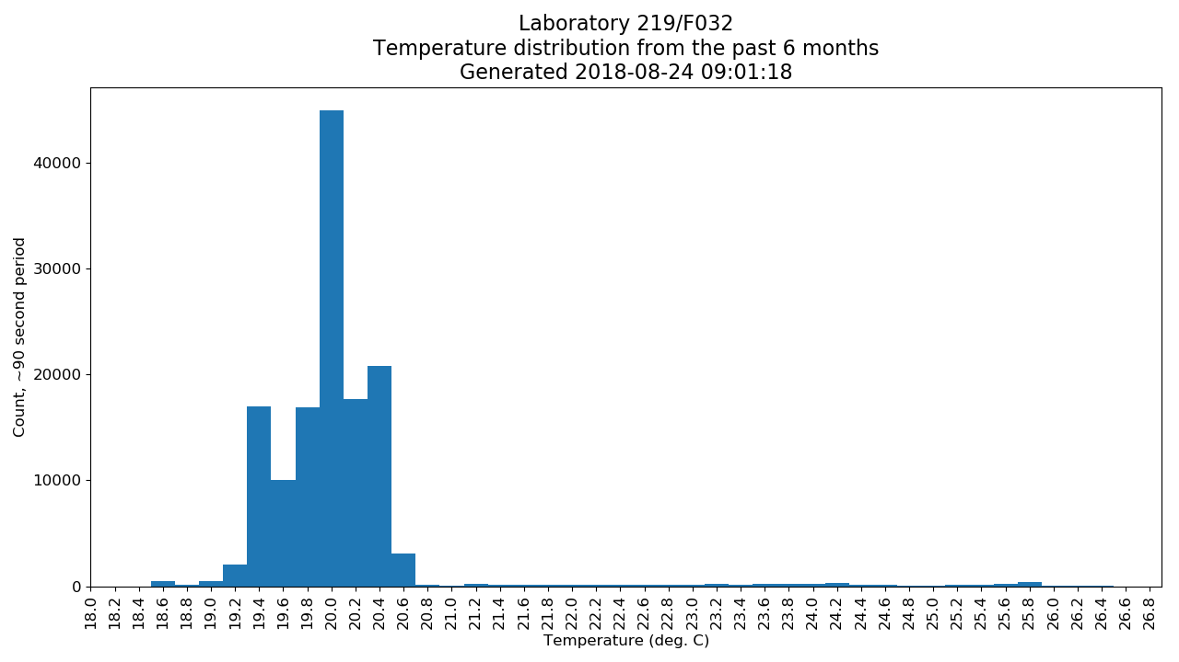
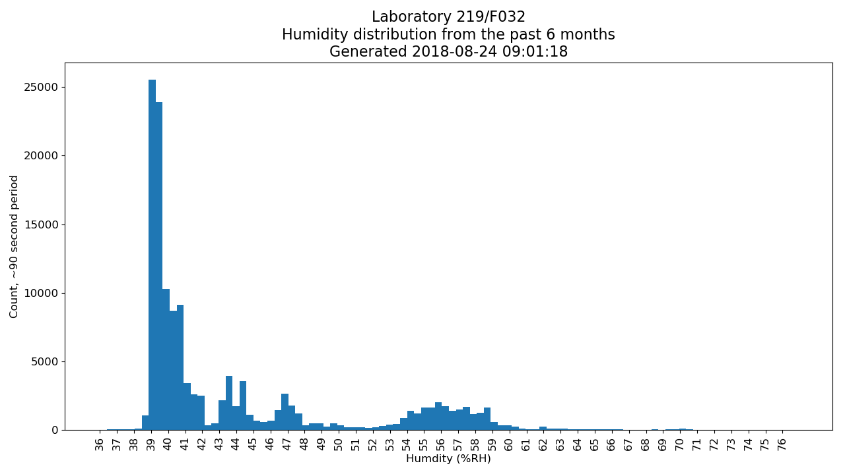
Example Data
www.nist.gov/pml/engineering-physics-division/dimensional-metrology
Dimensional Metrology Group
Engineering Physics Division
Physical Measurement Laboratory
Notes:
Finally, we can examine how the environment of a particular lab is distributed over some period. These graphs were all generated by our master system which generates a website, a link to the script will be posted at the end. The master system’s only purpose is to collect data from each device, process it according to how we want to view our data, and publish these past graphs every 5 minutes for each lab.

Slide 21
Overview
Purpose?
ISO 17025
Temperature and humidity in Dimensional Metrology
Design and cost
Example data
Lab environment incidents
Monitoring website
Link to Github download
www.nist.gov/pml/engineering-physics-division/dimensional-metrology
Dimensional Metrology Group
Engineering Physics Division
Physical Measurement Laboratory
Notes:
We should be pretty much out of time, but the last thing I would like to do is share the code in the form of a github link.

Slide 22
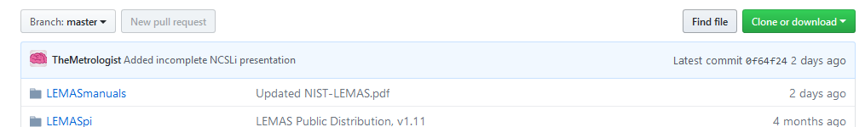
Freely available!
Download for NIST-developed environment monitoring:
LEMAS https://github.com/usnistgov/LEMASdistPub
Example master setup https://github.com/usnistgov/LEMASmaster
Contains:
Python 3 logging program, configurable alerts by email and text (MMS and SMS)
3D-printable model (.stl format) to mount 5 inch 800x480 display and Raspberry Pi 3
Instructions to install LEMAS onto Raspbian OS
Some configuration required (how-to is in instructions to install. Pdf or README)
Need to build interface for your sensor
www.nist.gov/pml/engineering-physics-division/dimensional-metrology
Dimensional Metrology Group
Engineering Physics Division
Physical Measurement Laboratory
Notes:
This is where you can download the python code to run your own logging and alert system. USNISTGOV is the official NIST github repository. The download contains: Python program to log data and send alert messages, a 3D-printable model to mount a raspberry pi 3 with a 5 inch 800x480 display, and instructions on how to install onto the primary raspberry pi operating system, Raspbian. I would rather have posted an image of Raspbian with the system installed so you can simply flash it onto a microSD card, but github has filesize limitations, 2 GB or so. It is entirely open source, you can peek through the code to ensure it isn’t doing anything malicious or collecting data. Ask me if you would like to make modifications or improvements, I would be more than happy. With this platform and Python setup, we or even you, could expand the system to do anything in the lab provided there is a means to acquire the data.
If you have never used github, like me prior to this, you can download the package by clicking the green button in the top right that says clone or download, then click download ZIP. Unpack the ZIP and all the files are inside, including the 3D printable model in one of the folders. Alternatively, you can use the git command from a linux terminal to download the package directly from github.

Slide 23
Freely available!
Download for NIST-developed environment monitoring:
LEMAS https://github.com/usnistgov/LEMASdistPub
Example master setup https://github.com/usnistgov/LEMASmaster
Thank you for your time!
Questions?
Michael Braine: michael.braine@nist.gov
(rarely near my phone, use email)
www.nist.gov/pml/engineering-physics-division/dimensional-metrology
Dimensional Metrology Group
Engineering Physics Division
Physical Measurement Laboratory
Notes:
Something that I would like to see come out of this is a modular smart-laboratory system, because devices these days are “smart devices” – smart cars, smart homes with smart thermostats. It makes sense to have a smart-lab, right?
That is all I have to share, and I would like to thank you very much for your time. If you give this a download and have problems setting it up on a Raspberry Pi, send me an email and if you’re nice I will be happy to help you out. Any questions?

